Slide 1


DIPARTIMENTO DI INGEGNERIA ELETTRICA E TECNOLOGIE DELL’INFORMAZIONE
SCUOLA POLITECNICA E DELLE SCIENZE DI BASE
LAUREA MAGISTRALE IN INGEGNERIA DELL’AUTOMAZIONE E ROBOTICA
Integral Sliding Mode Control for Trajectory Tracking of a Quad-rotor UAV with Chattering Attenuation and External Wrenches Estimation
Candidates: Domenico Tuccillo, Benito Vodola
Supervisor: Prof. Fabio Ruggiero
TITLE 1/26

Slide 2
Summary
Quav Dynamic Model
Trajectory Planning
Control Synthesis
Inner Loop Control Synthesis
Outer Loop Control Synthesis
Momentum-Based Estimator Synthesis
Simulation Results
Critics and final discussion
SUMMARY 2/26

Slide 3
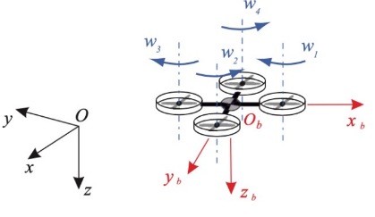
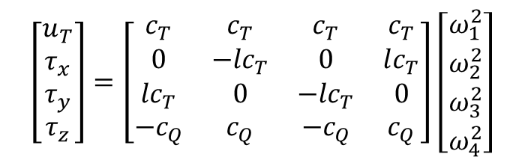
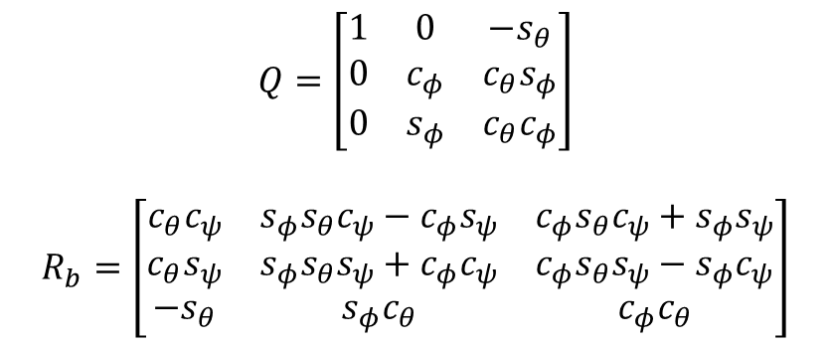
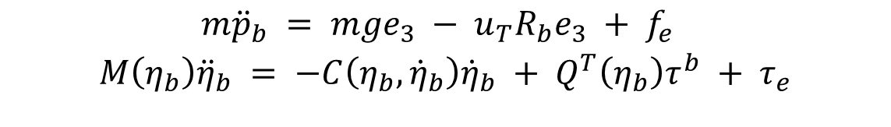
Dynamic model
$$m{\ddot{p}}_{b} = mge_{3} − u_{T}R_{b}e_{3} + {f_{e} }_{ }$$
$$M\left(η_{b}\right){\ddot{η}}_{b} = −C\left(η_{b}, {\dot{η}}_{b}\right){\dot{η}}_{b} + Q^{T}\left(η_{b}\right)τ^{b} + τ_{e}^{ }$$
$$Q=\left[\begin{matrix}1 & 0 & −s_{θ} \\ 0 & c_{φ} & c_{θ}s_{φ} \\ 0 & s_{φ} & c_{θ}c_{φ}\end{matrix}\right]$$
$$R_{b}=\left[\begin{matrix}c_{θ}c_{ψ} & s_{φ}s_{θ}c_{ψ}−c_{φ}s_{ψ} & c_{φ}s_{θ}c_{ψ}+s_{φ}s_{ψ} \\ c_{θ}s_{ψ} & s_{φ}s_{θ}s_{ψ}+c_{φ}c_{ψ} & c_{φ}s_{θ}s_{ψ}−s_{φ}c_{ψ} \\ −s_{θ} & s_{φ}c_{θ} & c_{φ}c_{θ}\end{matrix}\right]$$
$\left[\begin{matrix}u_{T} \\ τ_{x} \\ τ_{y} \\ τ_{z}\end{matrix}\right]=\left[\begin{matrix}c_{T} & c_{T} & c_{T} & c_{T} \\ 0 & {−lc}_{T} & 0 & lc_{T} \\ {lc}_{T} & 0 & {−lc}_{T} & 0 \\ −c_{Q} & c_{Q} & −c_{Q} & c_{Q}\end{matrix}\right]$ $\left[\begin{matrix}ω_{1}^{2} \\ ω_{2}^{2} \\ ω_{3}^{2} \\ ω_{4}^{2}\end{matrix}\right]$
DYNAMIC MODEL 3/26

Slide 4
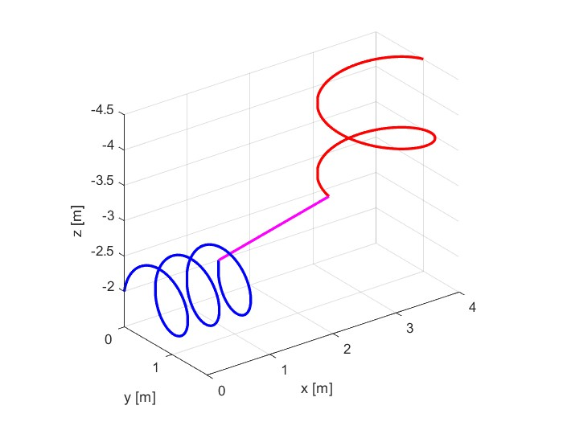
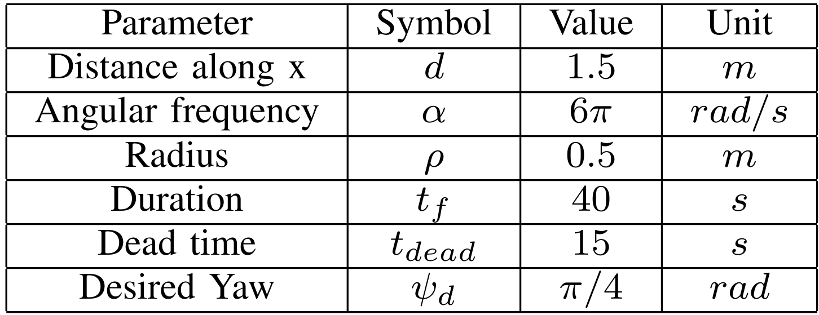
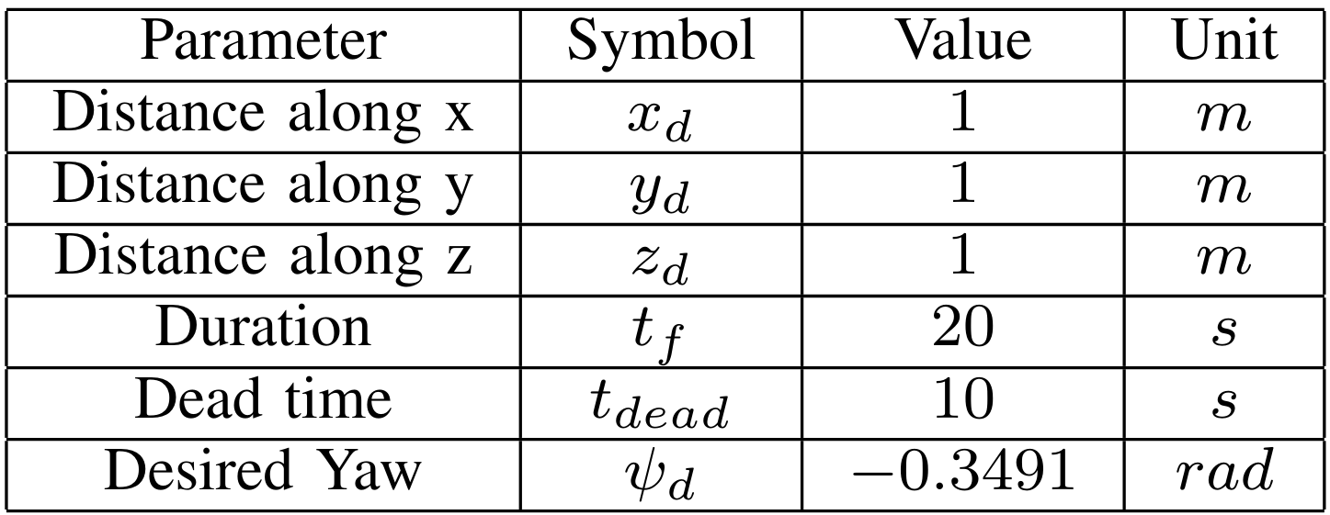
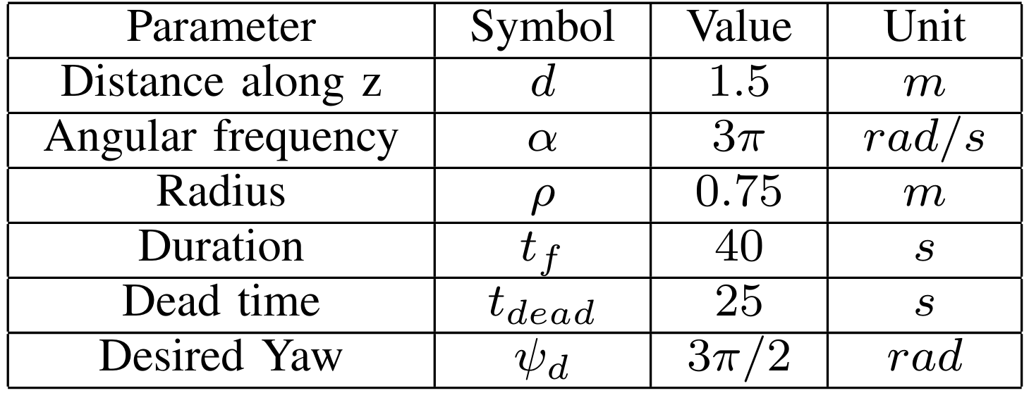
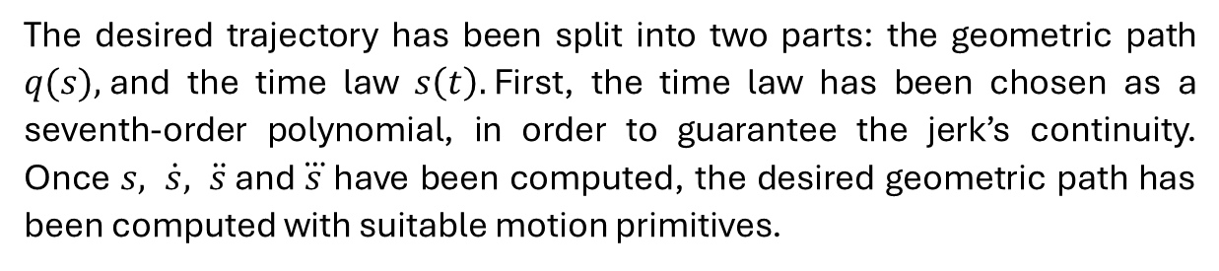
Trajectory planning
The desired trajectory has been split into two parts: the geometric path $q(s),$and the time law $s\left(t\right).$First, the time law has been chosen as a seventh-order polynomial, in order to guarantee the jerk’s continuity. Once $s, \dot{s}, \ddot{s}$and $\overset{⃛}{s}$ have been computed, the desired geometric path has been computed with suitable motion primitives.
TRAJECTORY PLANNING 4/26

Slide 5
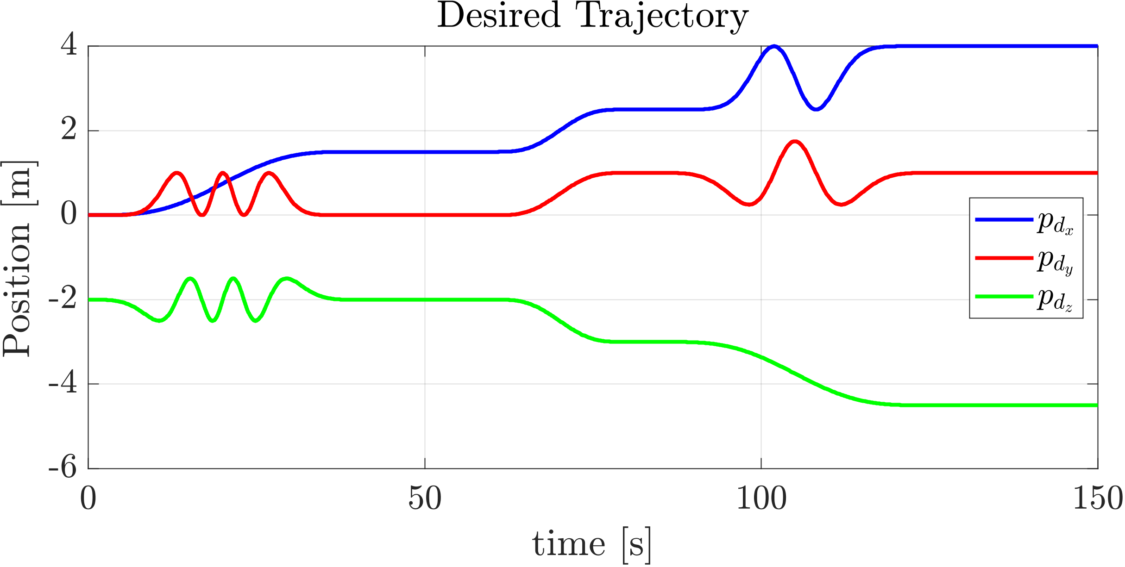
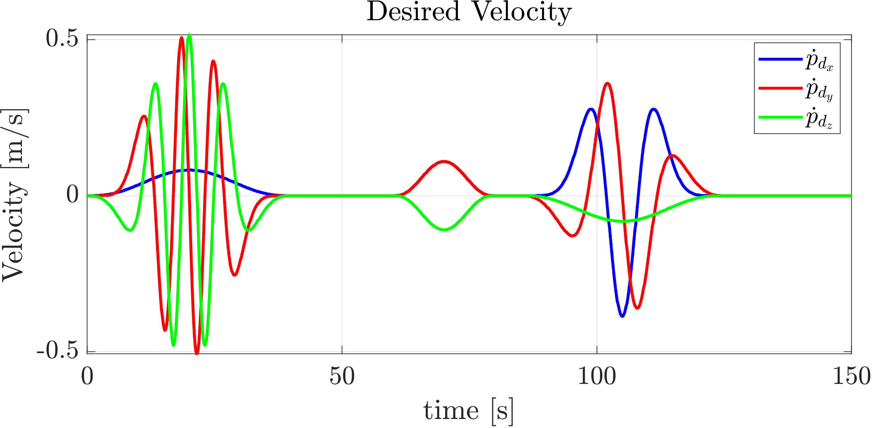
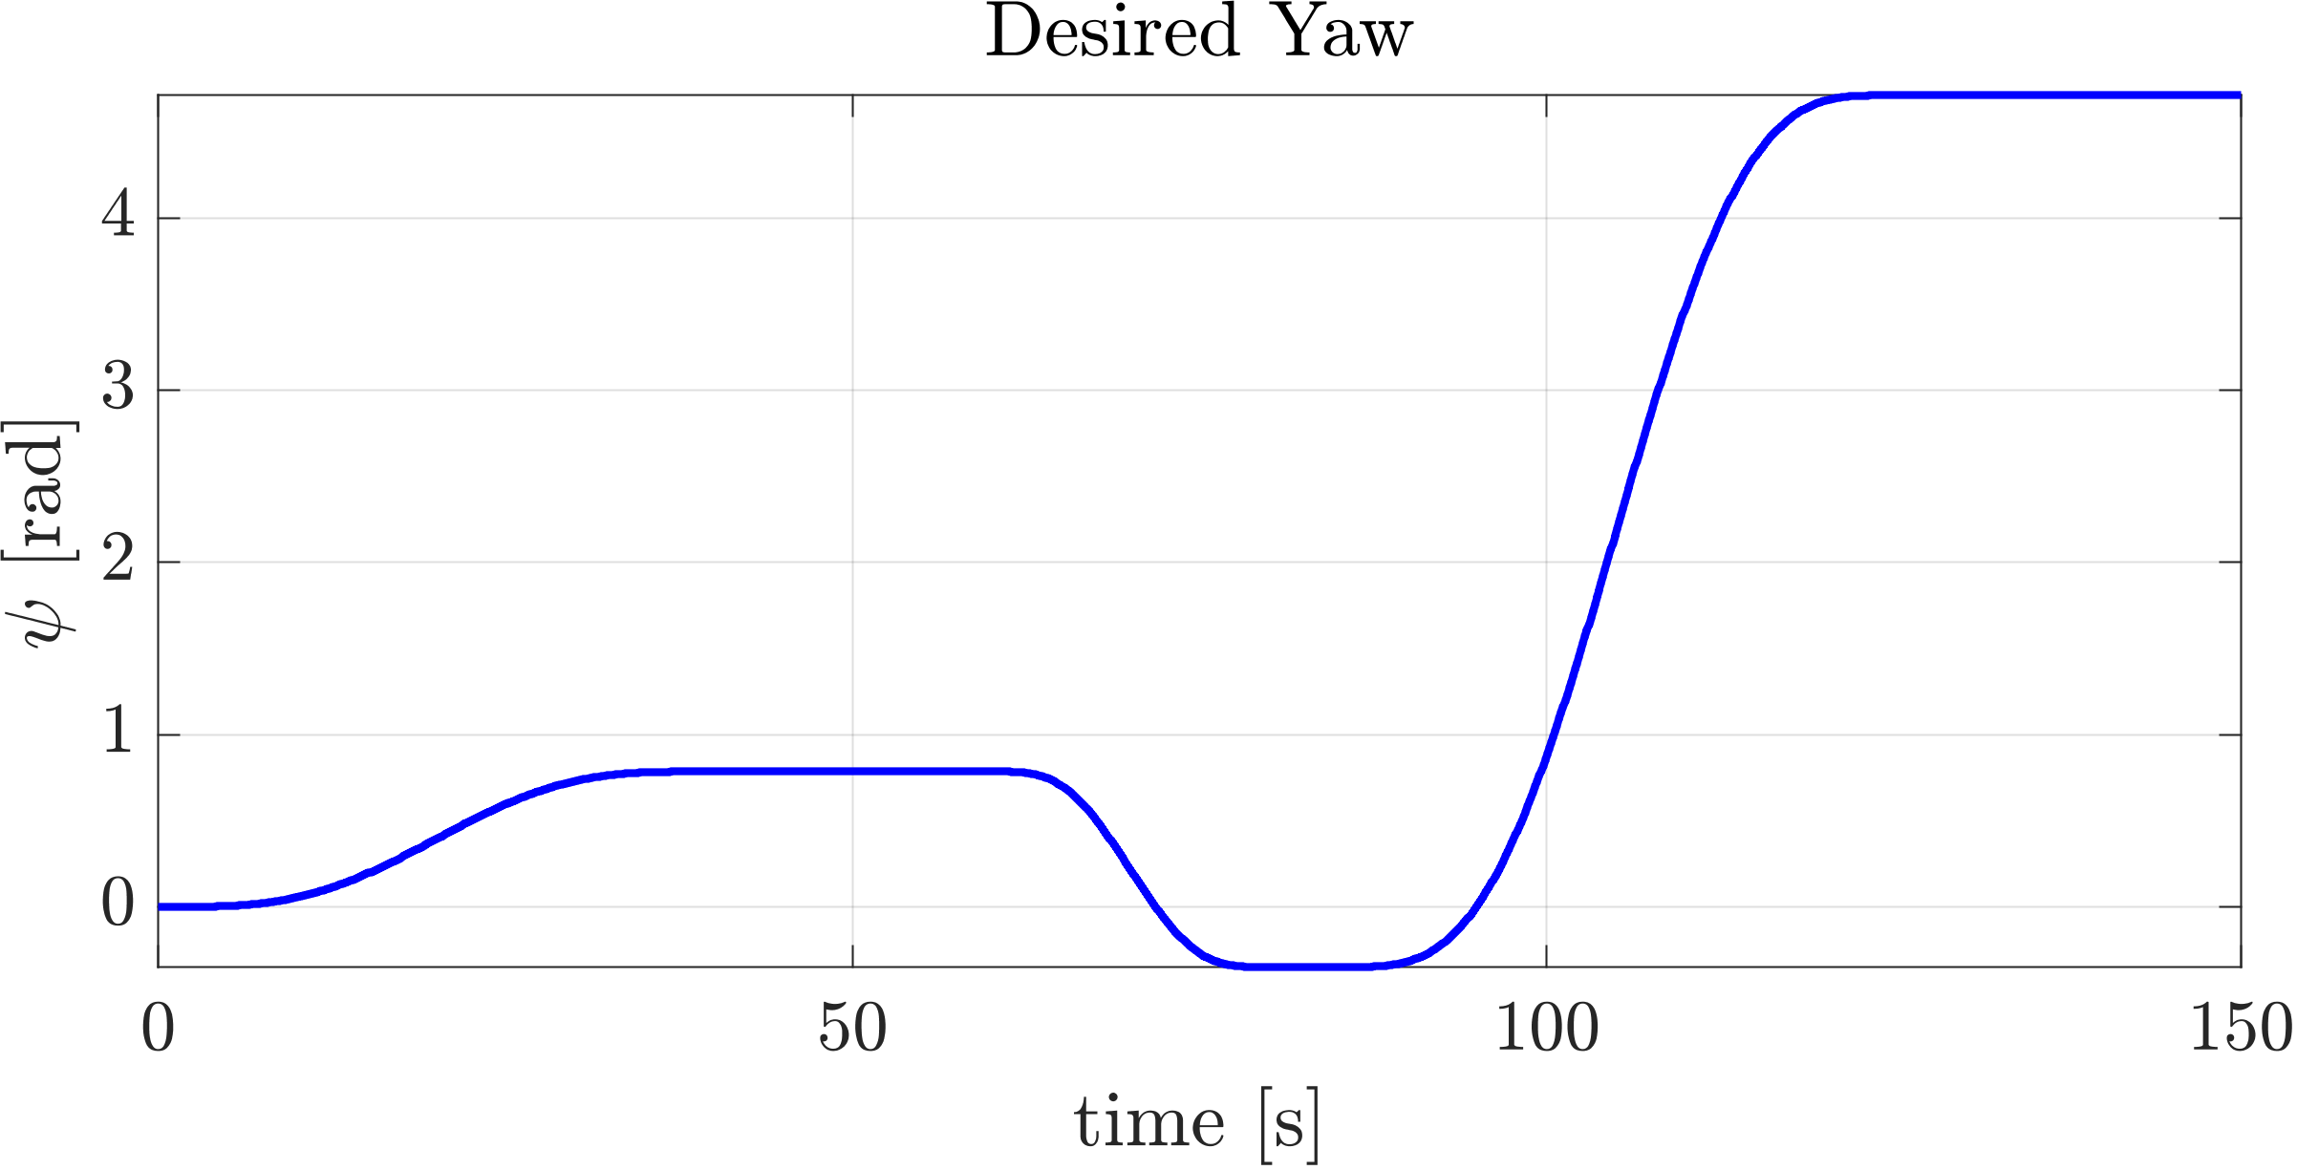
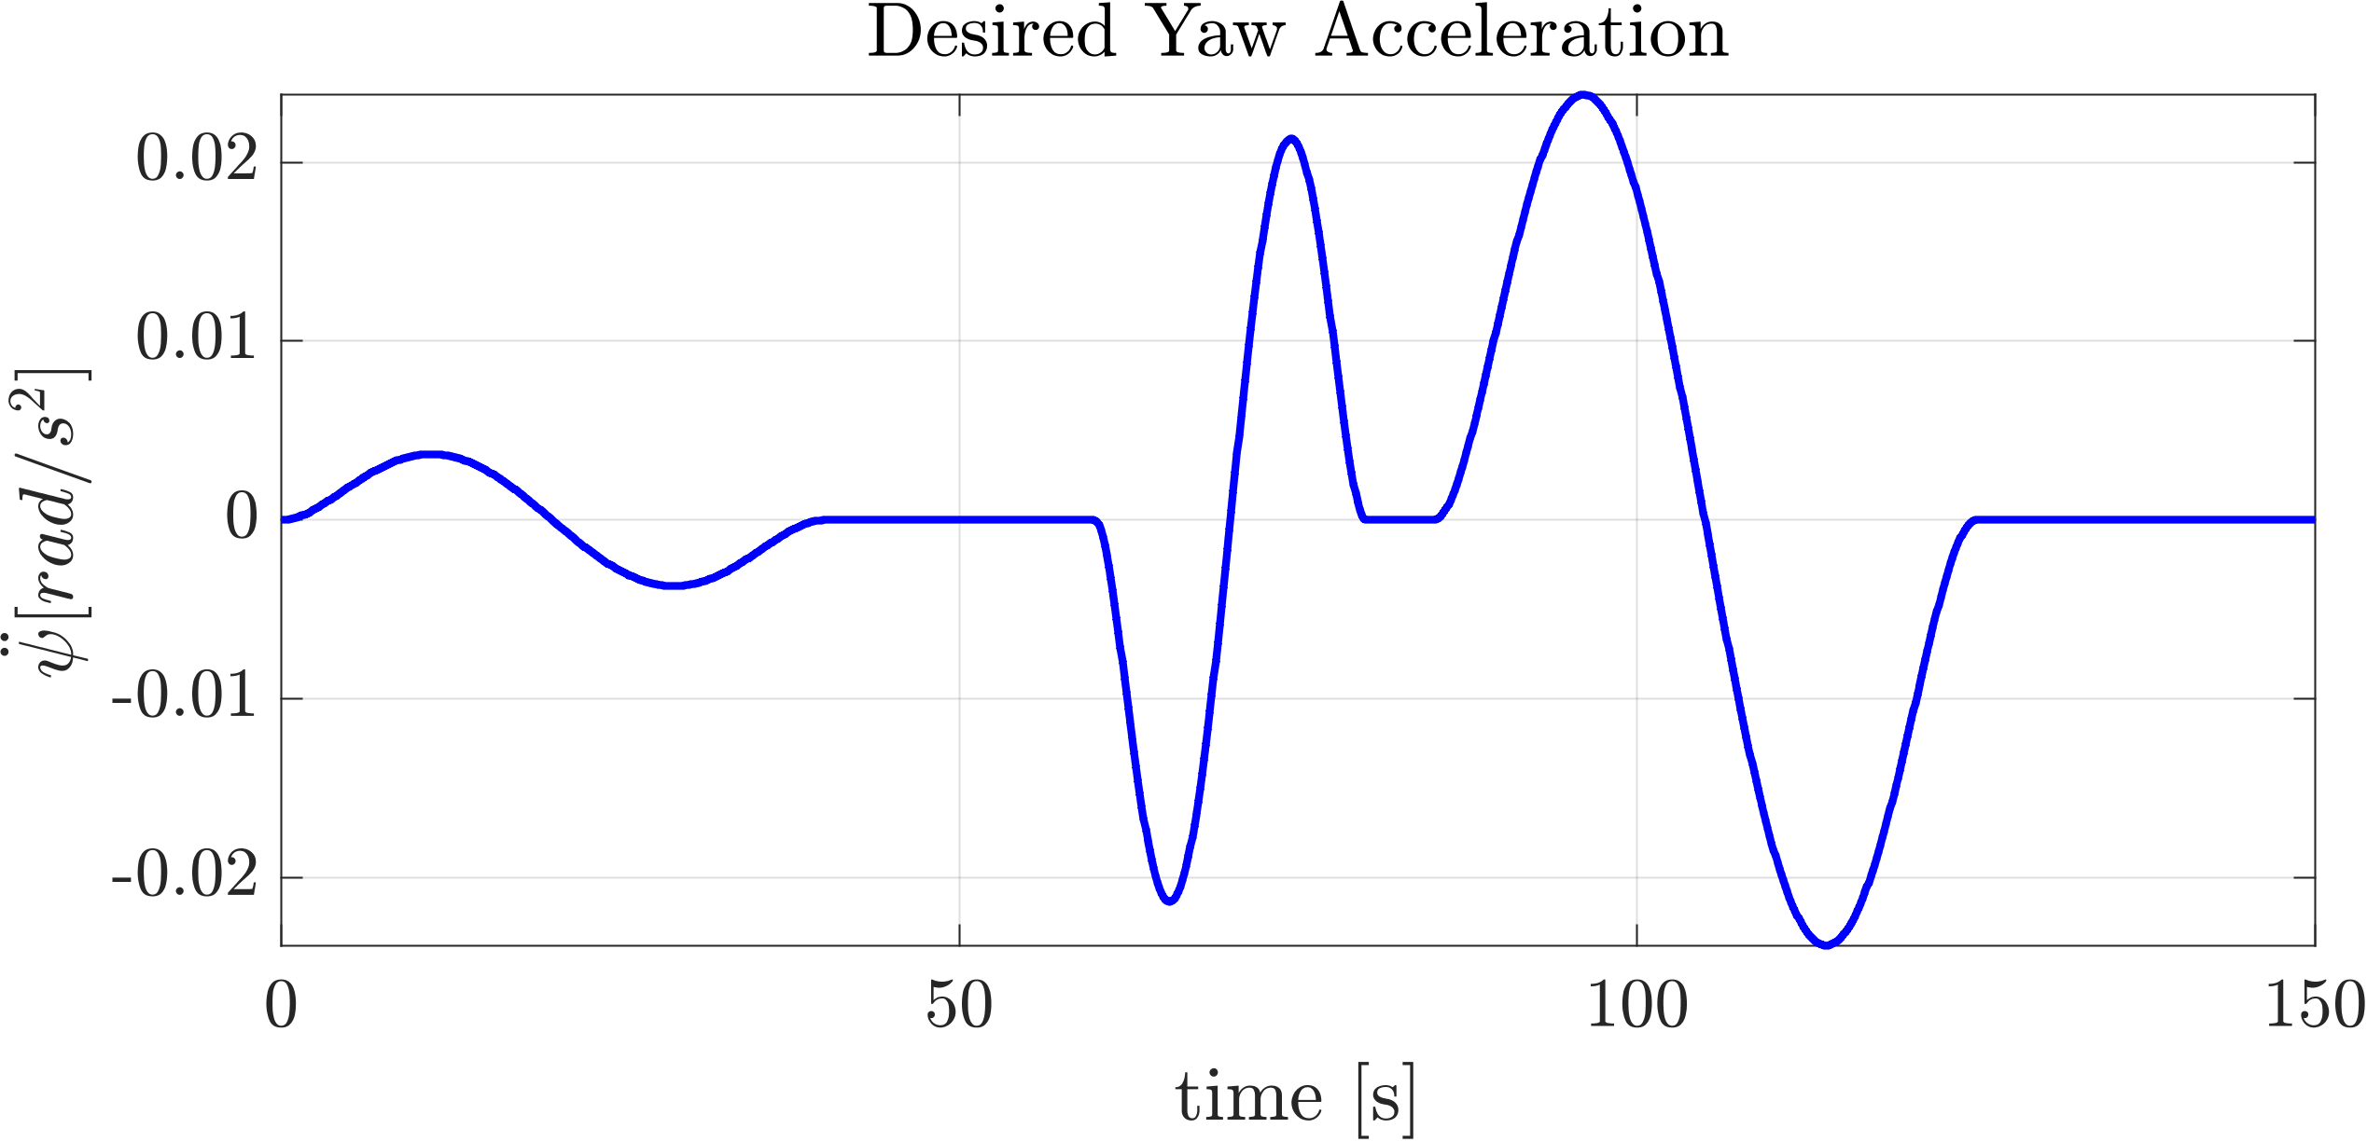
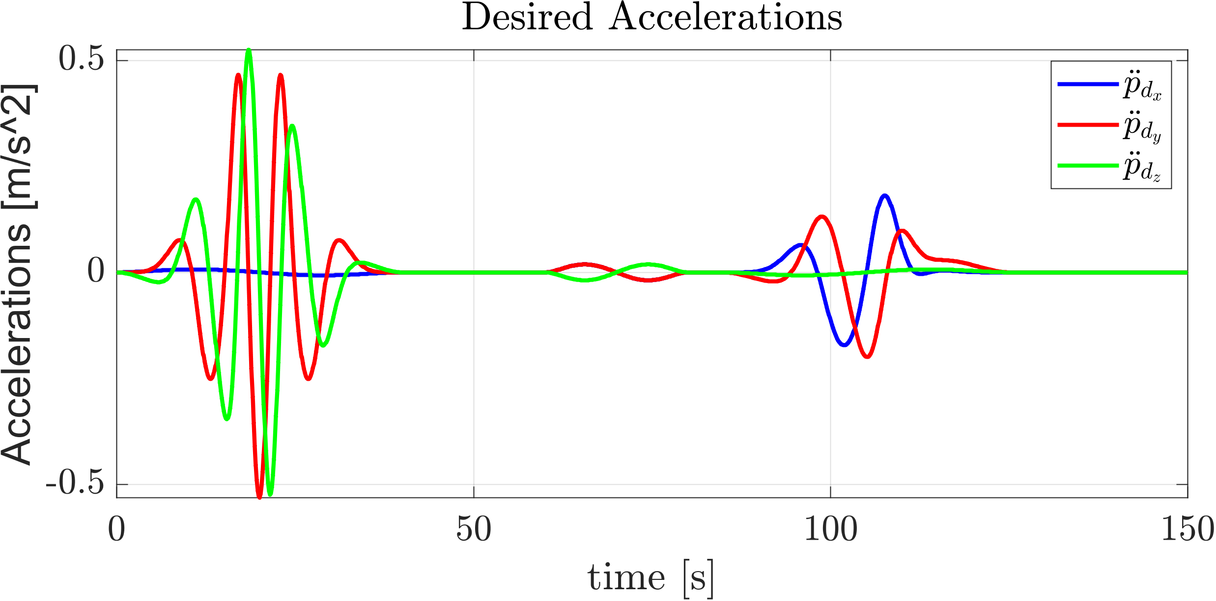
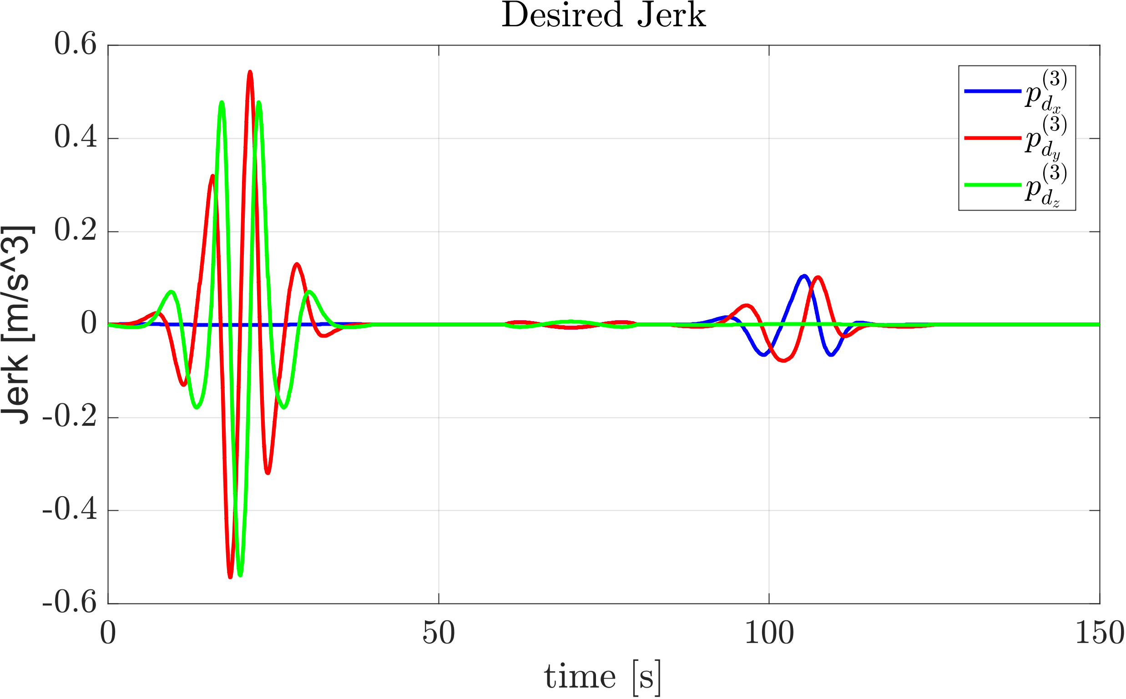
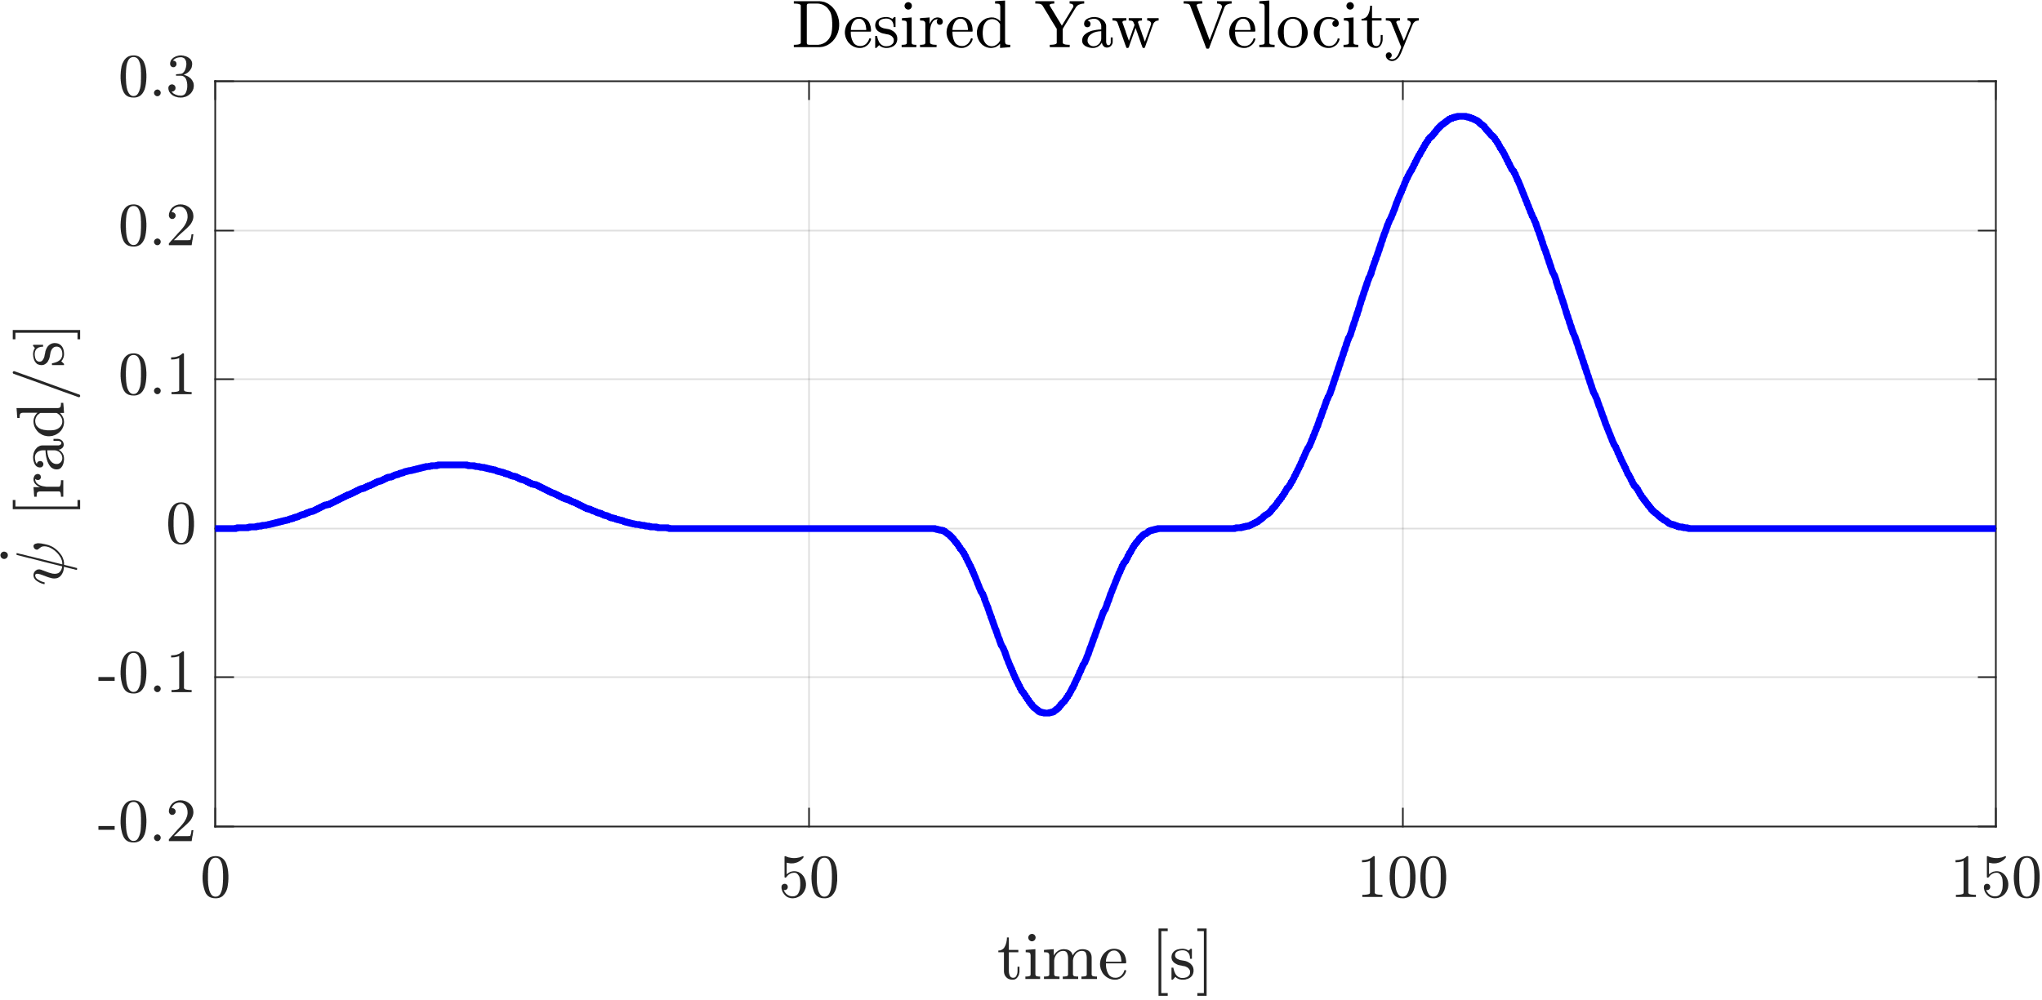
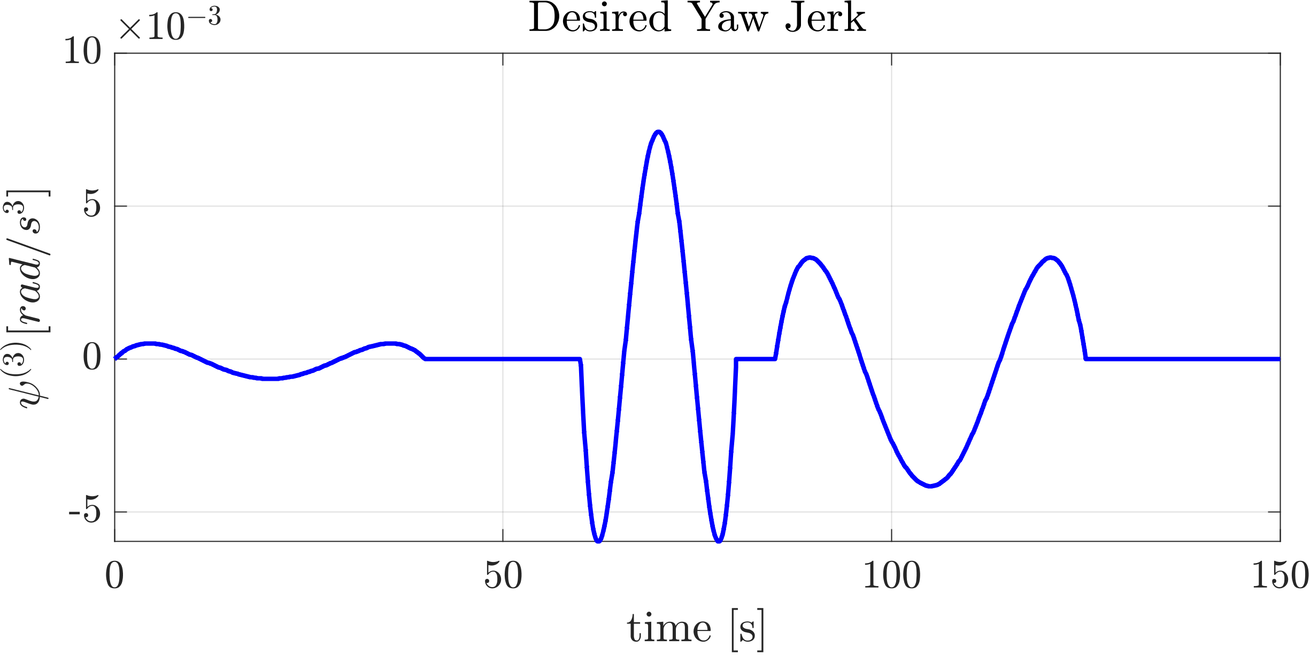
Trajectory Planning
TRAJECTORY PLANNING 5/26

Slide 6





Inner Loop Synthesis
The control objective is to design an ISMC control law to stabilize the error dynamics of the QUAV attitude and to bring it to the suitable sliding surface.
$$σ_{η} = {\dot{e}}_{η}+K_{1η}e_{η}+K_{2η}\int_{0}^{t}{e_{η}dτ (1)}$$
The proposed sliding surface is:
In order to prove stability and attractivity:
${\dot{σ}}_{η} = −λ_{1η}sgn\left(σ_{η}\right) − λ_{2η}σ_{η} \left(2\right)$
Deriving (1) with respect to time:
${\dot{σ}}_{η}=\left( {\ddot{η}}_{b}− {\ddot{η}}_{b,d}\right)+K_{1η}{\dot{e}}_{η}+K_{2η}e_{η} (3)$
Substituting the attitude dynamics (4) in (3)
$${\ddot{η}}_{b} =M{\left(η_{b}\right)}^{−1}[−C\left(η_{b}, {\dot{η}}_{b}\right){\dot{η}}_{b} + Q^{T}\left(η_{b}\right)τ^{b} + τ_{e}^{ }] \left(4\right)$$
Imposing (3)=(2) leads to the control law
$$τ^{b}=Q^{−T}M\left({\ddot{η}}_{d}+M^{−1}C {\dot{η}}_{b}−K_{2η}e_{η}−K_{1η} {\dot{e}}_{η}−λ_{1η}\operatorname{sgn}\left(σ_{η}\right)−λ_{2η}σ_{η}\right)−Q^{−T} {\hat{τ}}_{e}^{ }$$
INNER LOOP SYNTHESIS 6/26

Slide 7


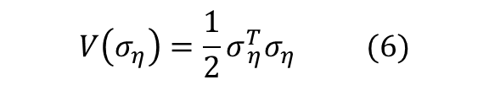
Inner Loop Stability Proof
The attractivity condition of the selected sliding surface, can be proven by selecting the candidate Lyapunov function as:
$$V\left(σ_{η}\right)=\frac{1}{2}σ_{ η}^{T}σ_{η} (6)$$
Deriving with respect to time and substituting (2) in (6):
$$\dot{V} = σ_{η}^{T}[−λ_{1η}{sgn⁡(σ}_{η}) − λ_{2η}σ_{η}]=−σ_{η}^{T}λ_{1η} sgn⁡(σ_{η})−λ_{2η}σ_{η}^{T} σ_{η}= \\ = −λ_{1,φ}\left|σ_{φ}\right|− λ_{1,θ} \left|σ_{θ}\right|−λ_{1,ψ} \left|σ_{ψ}\right|−λ_{2,φ}σ_{φ}^{2}− λ_{2,θ}σ_{θ}^{2}−λ_{2,ψ}σ_{ψ}^{2} (7)$$
For positive definite gains, attractivity of the sliding region is guaranteed by Lyapunov direct method since each terms of (7) will be negative definite except in the origin.
Once on the sliding region, the error dynamics is
$$\left( {\ddot{η}}_{b}− {\ddot{η}}_{b,d}\right)+K_{1η}{\dot{e}}_{η}+K_{2η}e_{η}=0 (8)$$
For positive definite gains, the error dynamics is GAS on the sliding surface, since (8) is linear homogeneous second order differential equation.
INNER LOOP SYNTHESIS 7/26

Slide 8


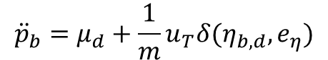

Outer Loop Synthesis
The control objective is to design a PD control law to stabilize the error dynamics of the QUAV position. The Outer Loop has been enhanced with an integral sliding action to bring it to the suitable sliding surface as in the Inner Loop Synthesis.
Forgetting for one moment that the system is underactuated and supposing of imposing a virtual desired acceleration $μ_{d}$ to the position dynamics:
$${\ddot{p}}_{b}=μ_{d}+\frac{1}{m}u_{T}δ(η_{b,d},e_{η})$$
A nonlinear interconnection term appears; the outer loop controller can be designed as follows and exploiting the perturbation theory it is possible to prove stability
$$μ_{d}={−K}_{1p}{\dot{e}}_{p}−K_{2p}e_{p}+{\ddot{p}}_{b,d}$$
Like the Inner Loop, by following similar steps and attractivity can be proved supposing to make the angular part faster than the position and to consider already vanished the interconnection term, in such way:
$${\ddot{p}}_{b}=μ_{d}$$
OUTER LOOP SYNTHESIS 8/26

Slide 9





Outer Loop Synthesis
$$σ_{p} = {\dot{e}}_{p}+K_{1p}e_{p}+K_{2p}\int_{0}^{t}{e_{p}dτ (1)}$$
The selected sliding surface is
In order to prove attractivity
${\dot{σ}}_{p} = −λ_{1p}sgn\left(σ_{p}\right) − λ_{2p}σ_{p} \left(2\right)$
Deriving (1) with respect to time
${\dot{σ}}_{p}=\left( {\ddot{p}}_{b}−{\ddot{p}}_{b,d}\right)+K_{1p}{\dot{e}}_{p}+K_{2p}e_{p} (3)$
Substituting the position dynamics (4) in (3)
${\ddot{p}}_{b}=μ_{d} (4)$
$$μ_{d}=−[K_{2p} K_{1p}] \left[\begin{matrix}e_{p} \\ {\dot{e}}_{p}\end{matrix}\right]{+\ddot{p}}_{b,d} − λ_{1p}sign⁡(σ_{p})−λ_{2p}σ_{p}−\frac{1}{m} {\hat{f}}_{e}$$
Imposing (3)=(2) leads to the control law
The attractivity proof is identical to the proof of attitude sliding surface.
In such way attractivity is proved just when the interconnection term is vanished, the complete stability proof still relies on perturbation theory
OUTER LOOP SYNTHESIS 9/26

Slide 10



Outer Loop Synthesis
Since the system is underactuated, the planner just provides the desired position and yaw. The desired thrust and full attitude can be computed from the flat output and the virtual control input.
$$u_{T}=m\sqrt{μ_{x}^{2}+μ_{y}^{2}+{\left(μ_{z}−g\right)}^{2}}$$
$$φ_{d}=\sin^{−1}\left(\frac{m}{u_{T}}\left(μ_{y}\cos{ψ_{d}}−μ_{x}\sin{ ψ_{d}}\right)\right)$$
$$θ_{d}=\tan^{−1}\left(\frac{μ_{x}\cos{ψ_{d}}+μ_{y}\sin{ ψ_{d}}}{μ_{z}−g}\right)$$
OUTER LOOP SYNTHESIS 10/26

Slide 11
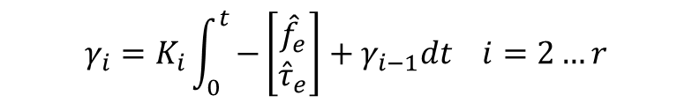
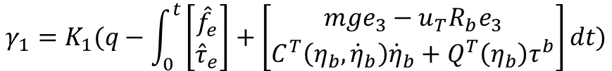

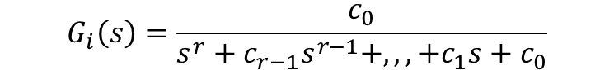
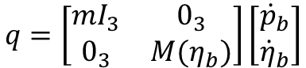

Momentum-Base Estimator Synthesis
The momentum-based estimator of order r has been proposed as the solution to estimate disturbances acting on the QUAV during the flight.
$$q=\left[\begin{matrix}mI_{3} & 0_{3} \\ 0_{3} & M(η_{b})\end{matrix}\right]\left[\begin{matrix}{\dot{p}}_{b} \\ {\dot{η}}_{b}\end{matrix}\right]$$
Through the computation of the momentum vector $q$:
$$G_{i}\left(s\right)=\frac{c_{0}}{s^{r}+c_{r−1}s^{r−1}+,,,+c_{1}s+c_{0}}$$
Then, the estimator of order r can be chosen as:
Once obtained these coefficients, first we have to compute the gains for the estimation:
$$\prod_{i=j+1}^{r}{K_{i}=c_{j}} j=0…r−1$$
$$γ_{1}=K_{1}(q−\int_{0}^{t}{\left[\begin{matrix}{\hat{f}}_{e} \\ {\hat{τ}}_{e}\end{matrix}\right]}+\left[\begin{matrix}mge_{3}−u_{T}R_{b}e_{3} \\ C^{T}\left(η_{b},{\dot{η}}_{b}\right){\dot{η}}_{b}+Q^{T}\left(η_{b}\right)τ^{b}\end{matrix}\right]dt)$$
Then, the estimation law is:
The sliding mode controller is already able to manage the disturbances and the uncertainties due to its robustness; however, the momentum-based estimator has been considered because it is able to provide the estimation of the disturbances and uncertainties that affect the system.
$$γ_{i}=K_{i}\int_{0}^{t}{−\left[\begin{matrix}{\hat{f}}_{e} \\ {\hat{τ}}_{e}\end{matrix}\right]}+γ_{i−1}dt i=2…r$$
MOMENTUM-BASED ESTIMATOR SYNTHESIS 11/26

Slide 12
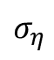
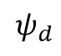
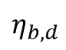
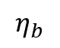
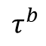
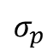
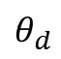
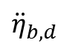
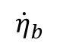
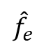
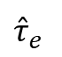
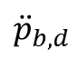
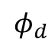
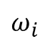
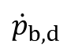
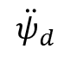
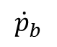
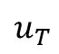
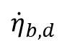
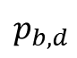
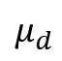
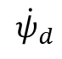
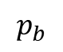
Control Scheme
$$p_{b,d}$$
PLANNER
$${\dot{p}}_{b,d}$$
Position Sliding Surface
$$σ_{p}$$
Position Controller
$$μ_{d}$$
Thrust and Attitude
$$u_{T}$$
Allocation Matrix
$$ω_{i}$$
UAV
$$p_{b}$$
$${\ddot{p}}_{b,d}$$
$${\dot{p}}_{b}$$
$${\hat{f}}_{e}$$
$$φ_{d}$$
$$θ_{d}$$
$$τ^{b}$$
$$η_{b}$$
$$ψ_{d}$$
Filter and Derivatives
$$η_{b,d}$$
Angular Sliding Surface
$$σ_{η}$$
Angular Controller
$${\dot{η}}_{b}$$
$${\dot{ψ}}_{d}$$
$${\ddot{ψ}}_{d}$$
$${\dot{η}}_{b,d}$$
$${\ddot{η}}_{b,d}$$
$${\hat{τ}}_{e}$$
External Wrenches Estimator
CONTROL SCHEME 12/26

Slide 13
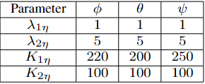
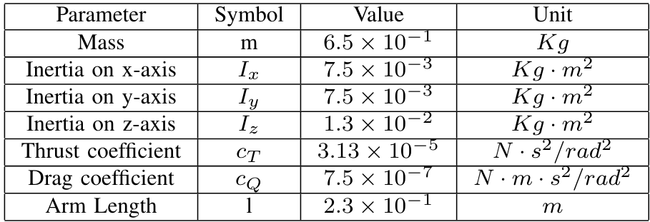
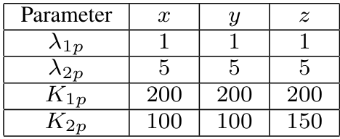

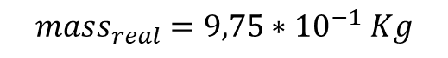

Parameters and case of study
The physical parameters of the QUAV and the selected control gains are:
The following cases will be analysed:
Simulation performed without uncertanties or external disturbances
Simulation performed with constant external disturbances
Simulation performed with constant external disturbances and estimator
Simulation performed with an uncertainty of 50% on the mass
Simulation performed with an uncertainty of 50% on the mass and estimator
$$f_{e}={\left[0 0 2\right]}^{T} N$$
$$τ_{e}^{ }={\left[5 5 5\right]}^{T}∗{10}^{−2} Nm$$
$$mass_{real}=9,75∗{10}^{−1} Kg$$
PARAMETERS AND CASE OF STUDY 13/26

Slide 14








Simulation Results
SIMULATION RESULTS 14/26

Slide 15




Simulation Results
SIMULATION RESULTS 15/26

Slide 16






Simulation Results: ISMC+Disturbances
SIMULATION RESULTS 16/26

Slide 17






Simulation Results: ISMC+Estimator+Disturbances
SIMULATION RESULTS 17/26

Slide 18
Comparison
CASE 1
CASE 2
CASE 3
The controller is still able to track the trajectory with sufficiently small errors, which are however bigger than the first case. furthermore, the transient is more evident. The thrust results much higher than the first case.
The transient is markedly reduced compared to the transient exhibited by the controller without compensation. Furthermore, the errors demonstrate a significantly lower order of magnitude with the incorporation of the estimator. This improvement underscores the effectiveness of the estimator in swiftly mitigating disturbances and reducing tracking errors, thus contributing to overall system stability and performance enhancement.
COMPARISON 18/26

Slide 19




Simulation Results: ISMC+Estimator+Disturbances
SIMULATION RESULTS 19/26

Slide 20






Simulation Results: ISMC+Uncertainty
SIMULATION RESULTS 20/26

Slide 21




Simulation Results: ISMC+Estimator+Uncertainty
SIMULATION RESULTS 21/26

Slide 22

Comparison
CASE 1
CASE 4
CASE 5
With a sufficient big gain on the control action, the controller will be robust. The transient of the pose error exhibits a smaller peak value than the case without the estimator we have reduced the peak for the third component of position error from $3 · {10}^{−3}m$to $20 · {{10}^{−}}^{5}m$.
Yaw error exhibits a slightly worse behavior than the case without the estimator; this is due to the estimator dynamics, which computes some values different from zero, but very small, that are comparable with such small error and interfere with it
COMPARISON 22/26

Slide 23





Simulation Results: ISMC+Estimator+Uncertainty
SIMULATION RESULTS 23/26

Slide 24
Critics and final discussion
The controller is on its own robust to uncertainties and external disturbances thanks to the sliding actions on Inner and Outer loop;
Performances can be improved by considering an external wrench estimator;
Using RPY dynamic model, the problem of representation singularities remains and could be fixed by considering a coordinate-free dynamic model;
Gain tuning can be tough since there are a lot of parameters;
The momentum-based estimator can affect badly the error dynamics sometimes.
CRISTICS AND FINAL DISCUSSION 24/26

Slide 25

Simulation Video
SIMULATION RESULTS 25/26

Slide 26
THANKS FOR YOUR ATTENTION
THANKS FOR YOUR ATTENTION 26/26

